Slide 1

BLOCK-CHAIN BASED E-CERTIFICATION
A project by CS-Clinic

Slide 2

Problems
Loss of certificate due to any mishap.
Verification of certificate is an issue because of organization may loss backups or it also may shift the platforms also many organizations issues unverifiable certificates.
Lot of time is required to prepare and distribute the certificates manually.

Slide 3

Solution
We are providing a platform to issue e-certificates and also providing a way to verify the issued certificates, to make the transparency of data & make the data available to other users for verification purposes we are using block-chain and if there is any data loss by some of the entity than other entities part of the network can still able to verify the certificates generated by that entity. Only authorized organization can participate in hosting this network of blockchain & allowed to make transactions.

Slide 4
Comparison of Different Block Chain Technologies
 | Ethereum | Hyperledger Fabric | R3 Corda | Ripple | Quorum | Hyperledger Sawtooth | EOS | Hyperledger Iroha | Stellar
Industry focus | Cross-Industry | Cross-Industry | Financial Services | Financial Services | Cross-Industry | Cross-Industry | Cross-Industry | Cross-Industry | Financial Services
Ledger Type | Permission less | Permissioned | Permissioned | Permissioned | Permissioned | Permissioned | Permissioned | Permissioned | Both Public & Private
Consensus Algorithm | Proof of Work | Pluggable Framework | Pluggable Framework | Probabilistic Voting | Majority Voting | Pluggable Framework | Delegated Proof-of-Stake | Chain-based Byzantine Fault Tolerant | Stellar Consensus Protocol
Smart Contract | Yes | Yes | Yes | No | No | Yes | Yes | Yes | Yes
Governance | Ethereum Developers | Linux Foundation | R3 Consortium | Ripple Labs | Ethereum Developers and JP Morgan Chase | Linux Foundation | EOSIO Core Arbitration Forum(ECAF) | Linux Foundation | Stellar Development Foundation
Cryptocurrency | Ether | No | No | Ripple(XRP) | Ether | - | - | - | -
Language For Smart Contract | Solidity | JavaScript, Java , Go | Kotlin, Java | C++ | Solidity | Go, Rust, Python, JavaScript | C++ | No Smart Contracts | JavaScript, Java, Go, Ruby, Python , C#

Slide 5
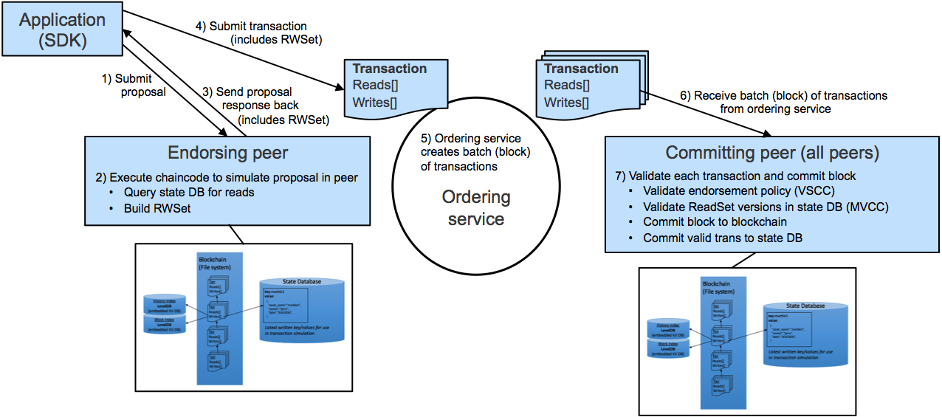
Features of Hyper Ledger Fabric
Permissioned membership.
Performance, scalability, and levels of trust.
Data on a need-to-know basis.
Rich queries over an immutable distributed ledger.
Modular architecture supporting plug-in components.
Protection of digital keys and sensitive data.
Workflow

